Slide 1
Is the
Projector Working?

Slide 2
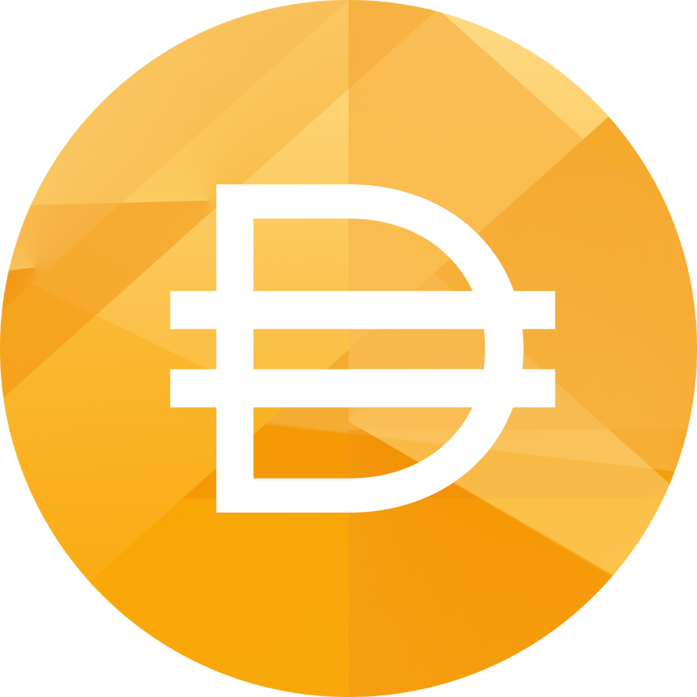



DAI Explainer
✊

Slide 3
What is DAI?
Stablecoin on the Ethereum Network
Decentralized like Ethereum
Spendable like dollars
Backed by a portfolio of collateral

Slide 4
What is DAI?
At the most basic level, behind all circulating Dai you will find collateral of greater value.
What follows is an explanation of:
How that is possible with volatile collateral? Using ETH as an example.
How does Dai hold its soft peg, trading reliably close to a dollar?

Slide 5
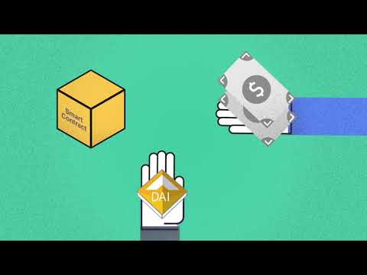

Slide 6
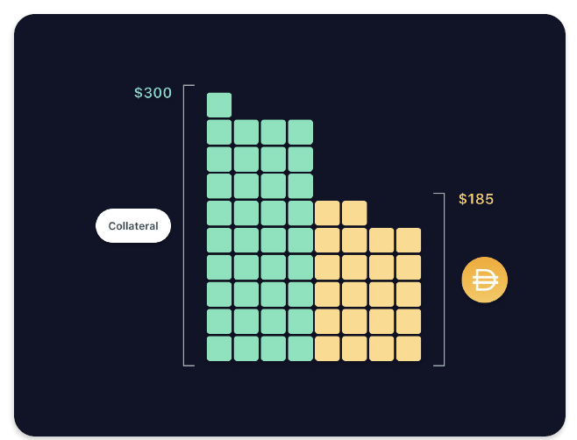
What is a Vault?
A vault is created when someone locks up their collateral

Slide 7
What is a Vault?
Repay Dai + fee to get your collateral back

Slide 8
What is a Vault?
Where does Dai come from when it is borrowed after creating a Vault?
Where does it go when it is repaid?

Slide 9
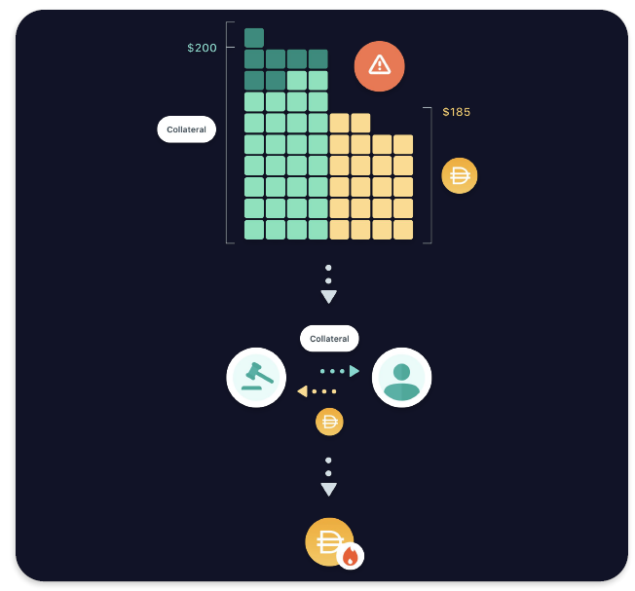

Liquidation🔥
If collateral falls in value, we must protect the Dai at all costs
Some collateral is auctioned off

Slide 10
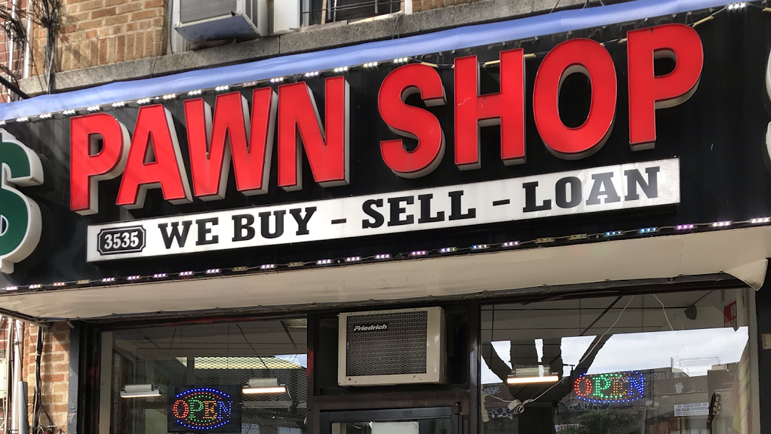
Pawn your Crypto

Slide 11
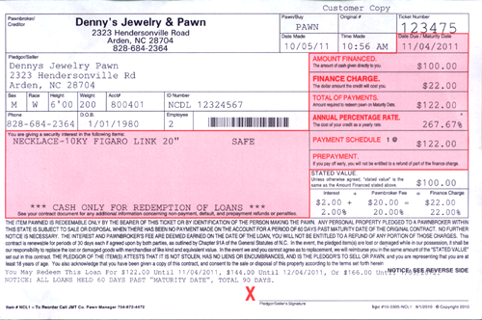

Slide 12


Assume stability fee = 10% & CDP open for 1 year
Maker
100 * .1 = 10
10 + 100 = 110
10%
110
1 ETH ($150) Smart Contract
Get your ETH back

Slide 13
How Strong? 💪
ETH fell from $1000 to $100 in a few months.
DAI stayed within plus or minus 5 cents
We just passed 2-years of Dai holding its peg
Dai transitioned to “Multi-Collateral Dai” over 3 months ago and 85% of the old Dai token (Sai) has been cashed out for the new Dai

Slide 14
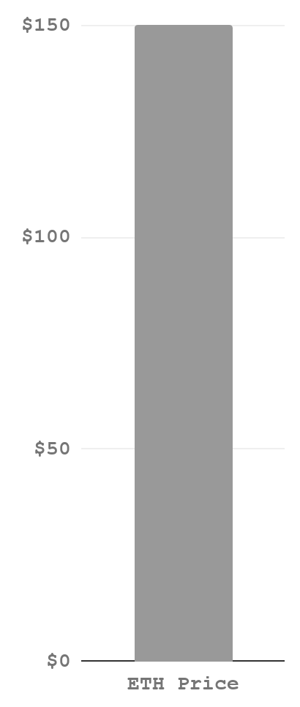
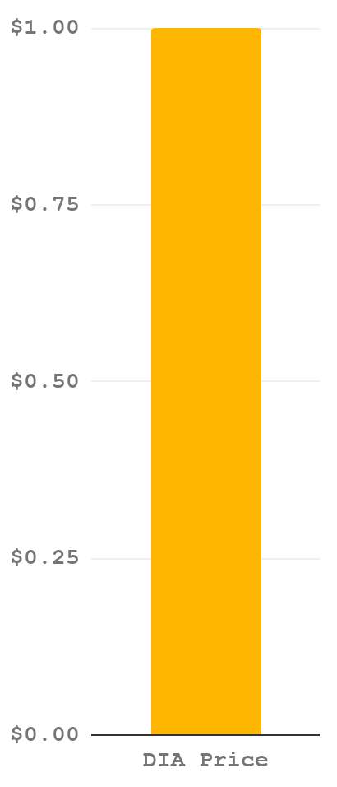
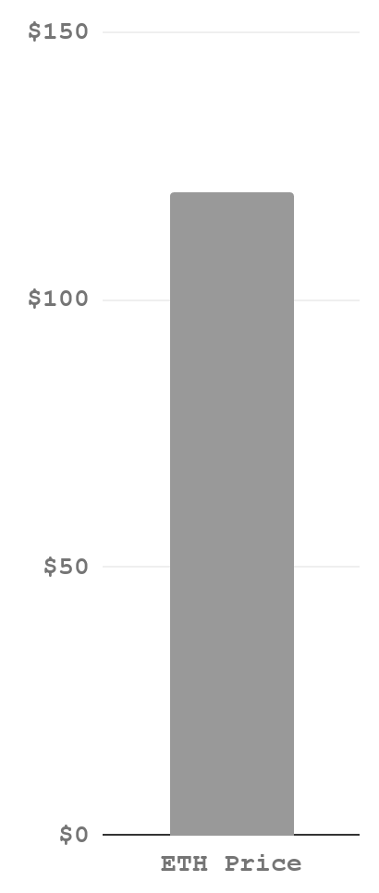
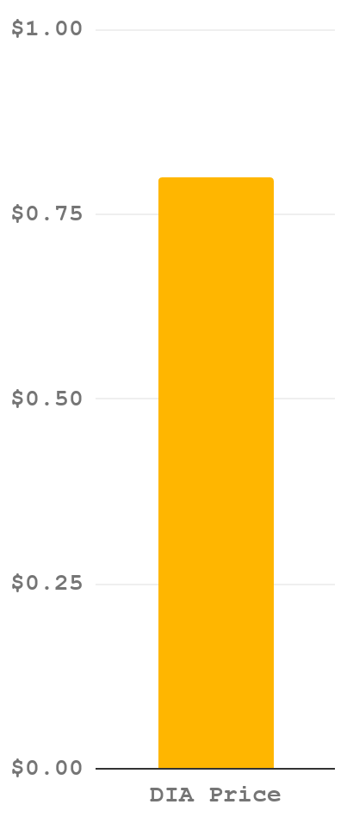
What if the price of ETH falls 20%?
=
?

Slide 15
What if the price of ETH falls 20%?
For Vaults that hold a low collateralization level, their ETH will be liquidated for DAI in order to close out their position.
If you want to prevent liquidation, you’ll need to add more ETH or repay some DAI.
Eli5: The stuff you gave us is worth less.
Give us more stuff, or give back some of the money we lent you, or we’re gonna sell your stuff to protect our butts.

Slide 16
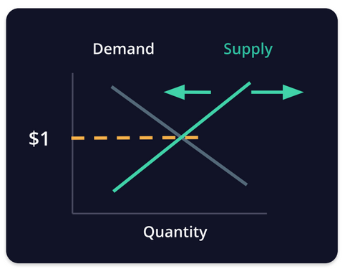
How peg?
Micro-level mechanism: Natural arbitrage opportunity for minting or paying back Dai.
Macro-level mechanism: MakerDAO governance Supply & Demand control by adjusting Stability Fees and the Dai Savings Rate.

Slide 17
How peg? Micro:
If Dai is trading below $1: Vault owners can acquire Dai at a discount to pay back their debt.
If Dai is trading above $1: Vault owners are incentivized to generate Dai to take advantage of boosted purchasing power.

Slide 18
How peg? Macro:
If Dai is trading below $1: Governance increases demand by raising the DSR. Governance decreases supply by raising Stability Fees.
If Dai is trading above $1: Governance decreases demand by lowing the DSR. Governance increases supply by lowering Stability Fees.

Slide 19
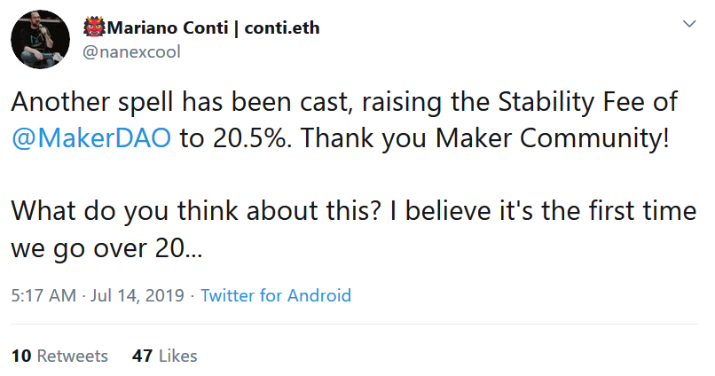
How peg? Who
Governance discussions & DAO votes determine adjustments in these rates.
Risk Teams make recommendations.
Public data dashboards are available to help voters make decisions.

Slide 20
Pause for Questions
Own a musket for home defense, since that's what the founding fathers intended. Four ruffians break into my house. "What the devil?" As I grab my powdered wig and Kentucky rifle. Blow a golf ball sized hole through the first man, he's dead on the spot. Draw my pistol on the second man, miss him entirely because it's smoothbore and nails the neighbors dog. I have to resort to the cannon mounted at the top of the stairs loaded with grape shot, "Tally ho lads" the grape shot shreds two men in the blast, the sound and extra shrapnel set off car alarms. Fix bayonet and charge the last terrified rapscallion. He Bleeds out waiting on the police to arrive since triangular bayonet wounds are impossible to stitch up. Just as the founding fathers intended.
(copypasta for the bored)

Slide 21
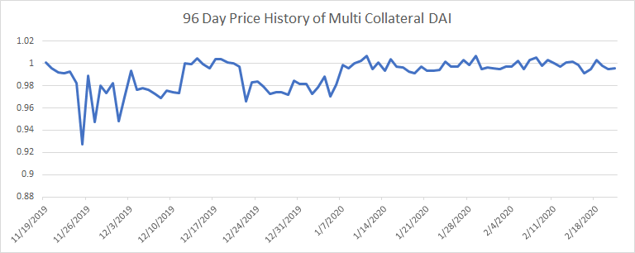
Is DAI Working?
$1
Average Price: .9897
Data Source: CoinGecko
Notes:
http://dai.descipher.io/

Slide 22
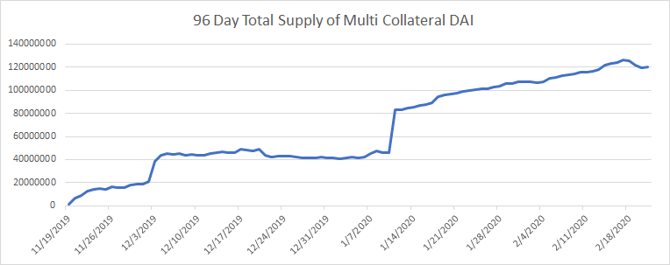
Is DAI Working?
Around 120mm now
Data Source: CoinGecko
Notes:
https://makerburn.com/#/chart
https://daistats.com/#/
https://docs.makerdao.com/

Slide 23
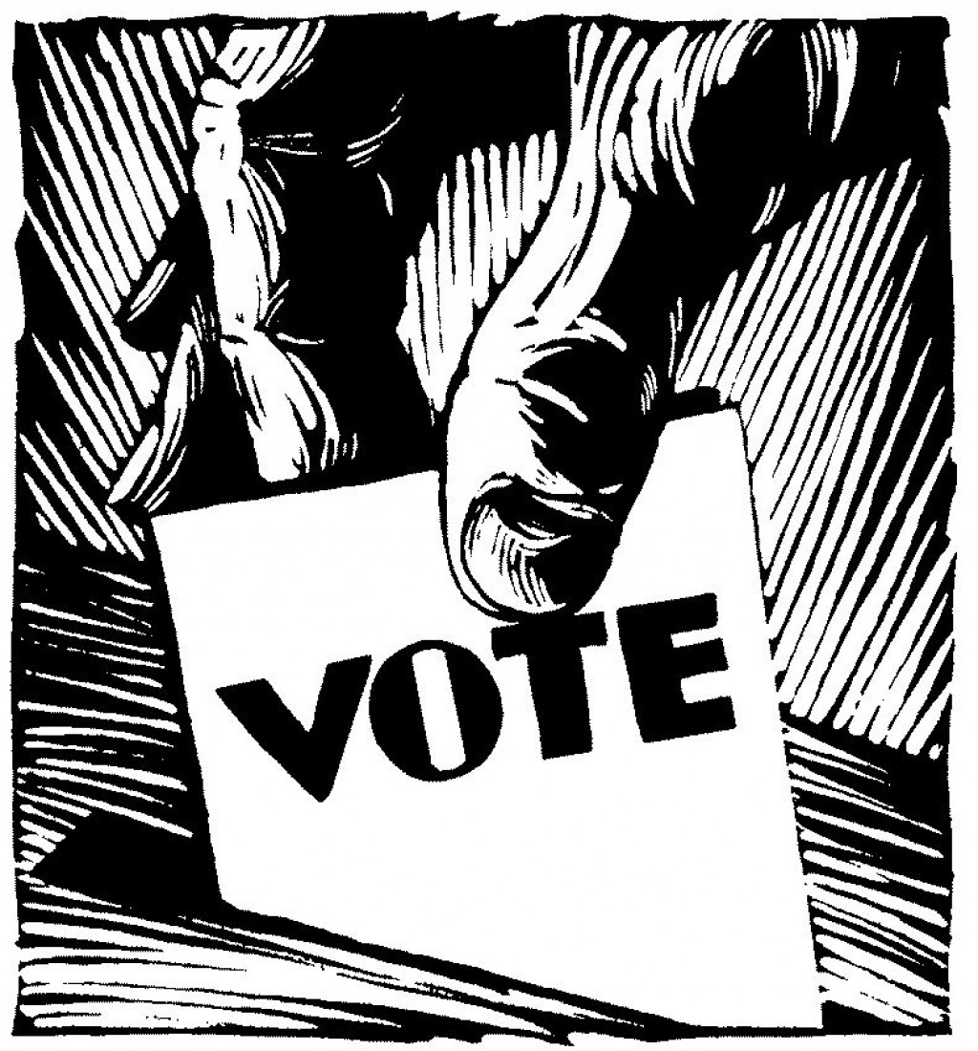
Join us in building MakerDAO
chat.makerdao.com
forum.makerdao.com
awesome.makerdao.com
community-development.makerdao.com

